Slide 1
Reading 57 Fintech in Investment Management
Learning outcomes
a. describe “fintech”
b. describe Big Data, artificial intelligence, and machine learning
c. describe fintech applications to investment management
d. describe financial applications of distributed ledger technology

Slide 2
WHAT IS FINTECH?
Early forms of fintech included data processing and the automation of routine tasks. Then followed systems that provided execution of decisions according to specified rules and instructions.
Fintech has since advanced into decision- making applications based on complex machine- learning logic, where computer programs are able to “learn” how to complete tasks over time.

Slide 3
WHAT IS FINTECH?
Whereas fintech covers a broad range of services and applications, areas of fintech development that are more directly relevant to the investment industry include the following:
Analysis of large datasets
Analytical tools
Automated trading
Automated advice
Financial record keeping

Slide 4
WHAT IS FINTECH?
Analysis of large datasets
Traditional data
Security prices, corporate financial statements, economic indicators
Non traditional data
Social media, sensor networks
Analytical tools
For extremely large datasets, techniques involving artificial intelligence (AI)—computer systems capable of performing tasks that previously required human intelligence—may be better suited to identify complex, non- linear relationships than traditional quantitative methods an statistical analysis.

Slide 5
WHAT IS FINTECH?
Automated trading
Executing investment decisions through computer algorithms or automated trading applications
Benefits: efficient trading, lower transaction costs, anonymity, greater access to market liquidity
Automated advice
Robo- advisers or automated personal wealth management services provide investment services to a larger number of retail investors at lower cost than traditional adviser models can provide.
Financial record keeping
New technology, such as DLT, may provide secure ways to track ownership of financial assets on a peer- to- peer (P2P) basis. By allowing P2P interactions—in which individuals or firms transact directly with each other without mediation by a third party—DLT reduces the need for financial intermediaries.

Slide 6
Practice
A correct description of fintech is that it:
A: is driven by rapid growth in data and related technological advances.
B: increases the need for intermediaries.
C: is at its most advanced state using systems that follow specified rules and instructions.

Slide 7
BIG DATA
Big Data includes data generated from traditional sources—such as stock exchanges, companies, and governments—as well as nontraditional data types, arising from the use of electronic devices, social media, sensor networks, and company exhaust
The term Big Data typically refers to datasets having the following characteristics:
Volume: Very Large
Velocity: Real- time or near- real- time data
Variety: structured data (e.g., SQL tables or CSV files), semi- structured data (e.g., HTML code), and unstructured data (e.g., video messages).

Slide 8
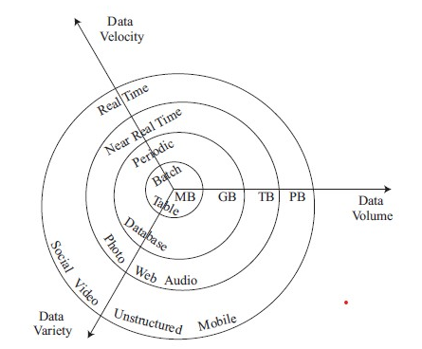
BIG DATA
Big Data Characteristics: Volume, Velocity, and Variety
Source: http://whatis.techtarget.com/definition/3Vs.

Slide 9
BIG DATA
Main sources of traditional data:
Financial market(e.g. equity, fixed income, futures, options, and other derivatives)
Governments(e.g. trade, economics, employment, and payroll data)
Three main sources of alternative data:
Data generated by individuals
Data generated by business processes
Data generated by sensors

Slide 10
BIG DATA
Big Data Challenges
Given the size and complexity of alternative datasets, traditional analytical methods cannot always be used to interpret and evaluate these datasets.
Big Data poses several challenges when it is used in investment analysis, including the quality, volume, and appropriateness of the data.
Does the dataset have selection bias, missing data, or data outliers?
Is the volume of collected data sufficient?
Is the dataset well suited for the type of analysis?

Slide 11
Practice
A characteristic of Big Data is that:
A: one of its traditional sources is business processes.
B: it involves formats with diverse types of structures.
C: real- time communication of it is uncommon due to vast content.

Slide 12
ARTIFICIAL INTELLIGENCE AND MACHINE LEARNING
Machine learning (ML) involves computer- based techniques that seek to extract knowledge from large amounts of data without making any assumptions on the data’s underlying probability distribution.
Simply put, ML algorithms aim to “find the pattern, apply the pattern.”
ML still requires human judgement in understanding the underlying data and selecting the appropriate techniques for data analysis.

Slide 13
ARTIFICIAL INTELLIGENCE AND MACHINE LEARNING
ML involves splitting the dataset into three distinct subsets: a training dataset, a validation dataset, and a test dataset.
The training dataset allows the algorithm to identify relationships between inputs and outputs based on historical patterns in the data.
These relationships are then validated, and the model tuned, using the validation dataset.
The test dataset is used to test the model’s ability to predict well on new data.
Challenges in machine learning
Overfitting occurs when the ML model learns the input and target dataset too precisely
Underfitted models will typically fail to fully discover patterns that underlie the data.
ML techniques can appear to be opaque or “black box” approaches, which arrive at outcomes that may not be entirely understood or explainable.

Slide 14
ARTIFICIAL INTELLIGENCE AND MACHINE LEARNING
Types of Machine Learning
In supervised learning, computers learn to model relationships based on labeled training data.
In unsupervised learning, computers are not given labeled data but instead are given only data from which the algorithm seeks to describe the data and their structure.
In deep learning, computers use neural networks, often with many hidden layers, to perform multistage, non- linear data processing to identify patterns.

Slide 15
Practice
In the use of machine learning (ML):
A: some techniques are termed “black box” due to data biases.
B: human judgment is not needed because algorithms continuously learn from data.
C: training data can be learned too precisely, resulting in inaccurate predictions when used with different datasets.

Slide 16
DATA SCIENCE: EXTRACTING INFORMATION FROM BIG DATA
Data science can be defined as an interdisciplinary field that harnesses advances in computer science (including machine learning), statistics, and other disciplines for the purpose of extracting information from Big Data (or data in general).
Data Processing Methods
Capture—Data capture refers to how the data are collected and transformed into a format that can be used by the analytical process.(low/high latency system)
Curation—Data curation refers to the process of ensuring data quality and accuracy through a data cleaning exercise.(inaccurate/missing data)
Storage—Data storage refers to how the data will be recorded, archived, and accessed and the underlying database design.
Search—Search refers to how to query data.
Transfer—Transfer refers to how the data will move from the underlying data source or storage location to the underlying analytical tool.

Slide 17
DATA SCIENCE: EXTRACTING INFORMATION FROM BIG DATA
Data Visualization
Data visualization is an important tool for understanding Big Data. Visualization refers to how the data will be formatted, displayed, and summarized in graphical form.
Traditional structured data can be visualized using tables, charts, and trends, whereas non- traditional unstructured data require new techniques of data visualization.

Slide 18
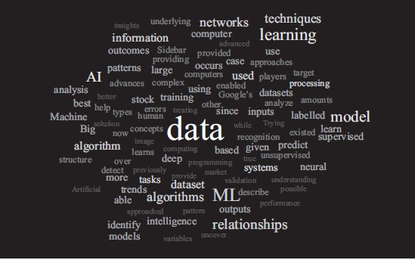
DATA SCIENCE: EXTRACTING INFORMATION FROM BIG DATA
Data Visualization Tag Cloud
Source: http://worditout.com/word-cloud/create

Slide 19
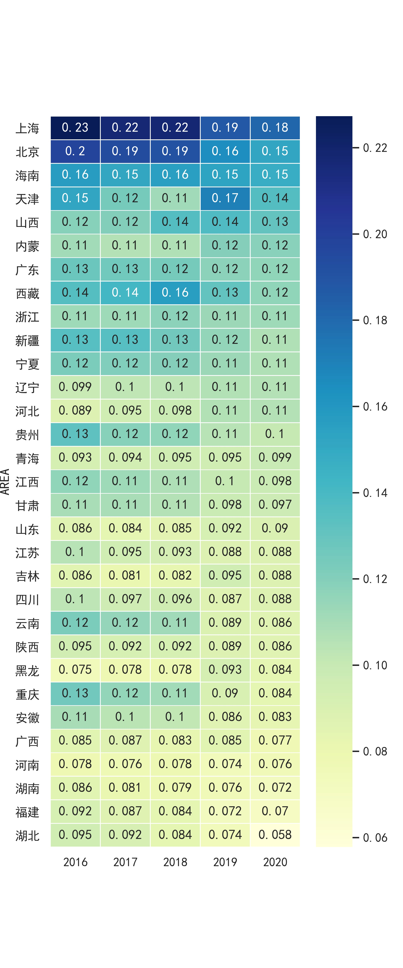
DATA SCIENCE: EXTRACTING INFORMATION FROM BIG DATA
Data Visualization Heatmap

Slide 20
DATA SCIENCE: EXTRACTING INFORMATION FROM BIG DATA
Programming Languages
Python
R
Java
C/C++
Excel VBA
Databases
SQL
SQLite
NoSQL

Slide 21
SELECTED APPLICATIONS OF FINTECH TO INVESTMENT MANAGEMENT
Text Analytics and Natural Language Processing
Text analytics involves the use of computer programs to analyze and derive meaning typically from large, unstructured text- or voice- based datasets.
Natural language processing (NLP) is a field of research at the intersection of computer science, artificial intelligence, and linguistics that focuses on developing computer programs to analyze and interpret human language.
Automated tasks using NLP include translation, speech recognition, text mining, sentiment analysis, and topic analysis.
Models using NLP analysis may incorporate non- traditional information to evaluate what people are saying—via their preferences, opinions, likes, or dislikes—in an attempt to identify trends and short- term indicators about a company, a stock, or an economic event that might have a bearing on future performance.

Slide 22
Practice
Text Analytics is appropriate for application to:
A: economic trend analysis.
B: large, structured datasets.
C: public but not private information.

Slide 23
SELECTED APPLICATIONS OF FINTECH TO INVESTMENT MANAGEMENT
Robo- Advisory Services
As robo-advisers have been incorporated into the investment landscape, they have drawn the attention of regulatory authorities. Although regulatory conditions vary, robo-advisers are likely to be held to a similar level of scrutiny and code of conduct as other investment professionals in the given region.
Although their analyses and recommendations can cover both active and passive management styles, most robo-advisers follow a passive investment approach.
Because of their low- cost structure, robo-advisers can reach underserved populations, such as the mass affluent or mass market segments, which are less able to afford a traditional financial adviser.

Slide 24
SELECTED APPLICATIONS OF FINTECH TO INVESTMENT MANAGEMENT
Two types of wealth management services dominate the robo- advice sector: fully automated digital wealth managers and adviser- assisted digital wealth managers.
Critics of robo- advisers
It may not always be completely transparent why a robo- adviser chooses to make a recommendation or take a trading action that it did.
There may be trust issues in allowing computers to make these decisions, including worries of instances where robo- advisers might recommend inappropriate investments.
As the complexity and size of an investor’s portfolio grows, robo- advisers may not be able to sufficiently address the particular preferences and needs of the investor.

Slide 25
Practice
In providing investment services, robo- advisers are most likely to:
A rely on their cost effectiveness to pursue active strategies.
B offer fairly conservative advice as easily accessible guidance.
C be free from regulation when acting as fully- automated wealth managers.

Slide 26
SELECTED APPLICATIONS OF FINTECH TO INVESTMENT MANAGEMENT
Risk Analysis
As mandated by regulators worldwide, the global investment industry has undertaken major steps in stress testing and risk assessment that involve the analysis of vast amounts of quantitative and qualitative risk data.

